Slide 1
Master
Valorisation du patrimoine
Ph. Romanski

Slide 2
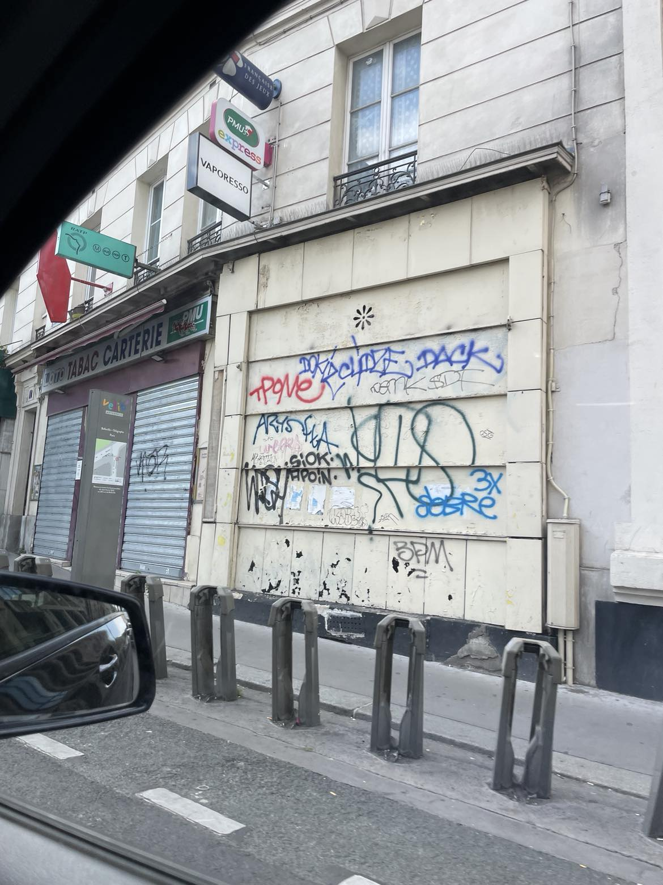

Slide 3
  Graffiti as Heritage ?
  From inscription to protection
  —2 cases —

Slide 4

https://www.youtube.com/watch?v=9lH_1Uf9B8U

Slide 5
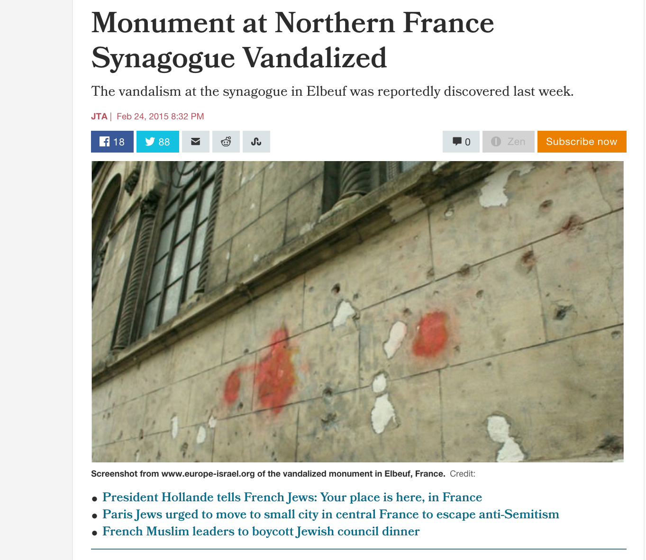

Slide 6
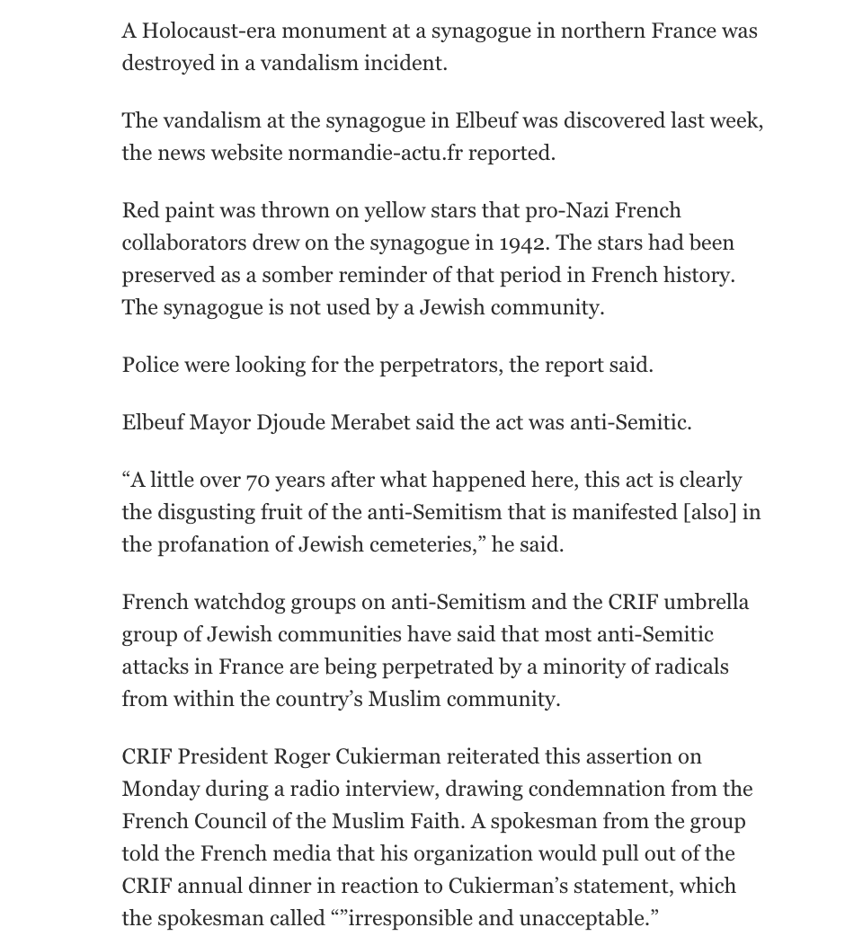

Slide 7
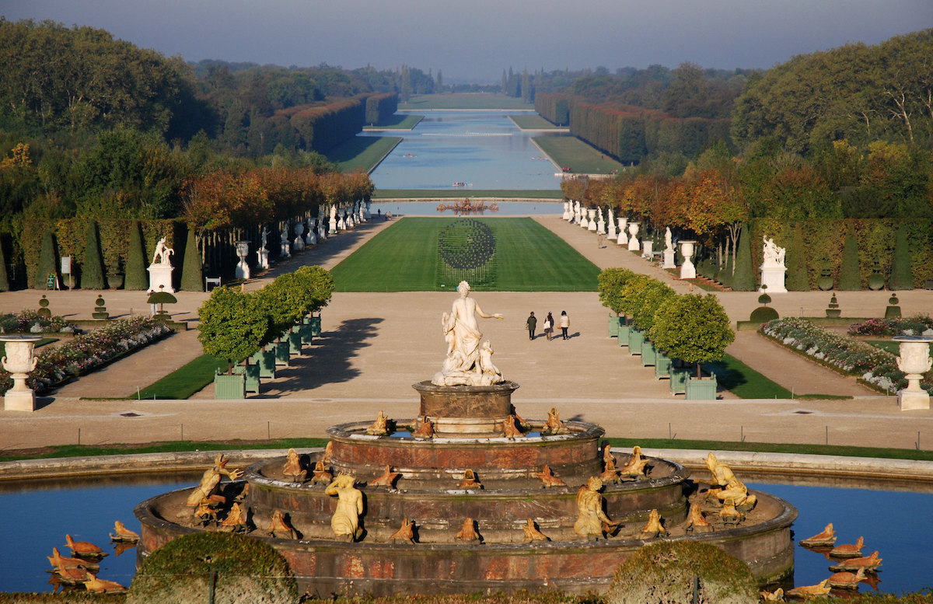

Slide 8
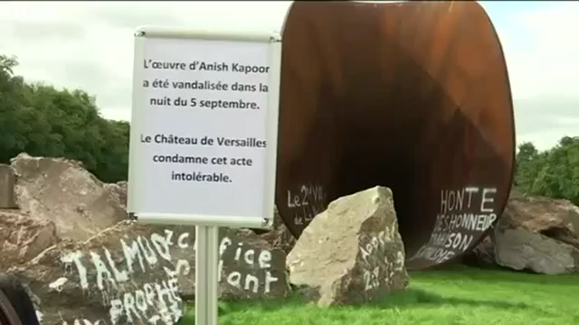
September 2015
https://www.youtube.com/watch?v=aV2tN7-1Zqo

Slide 9
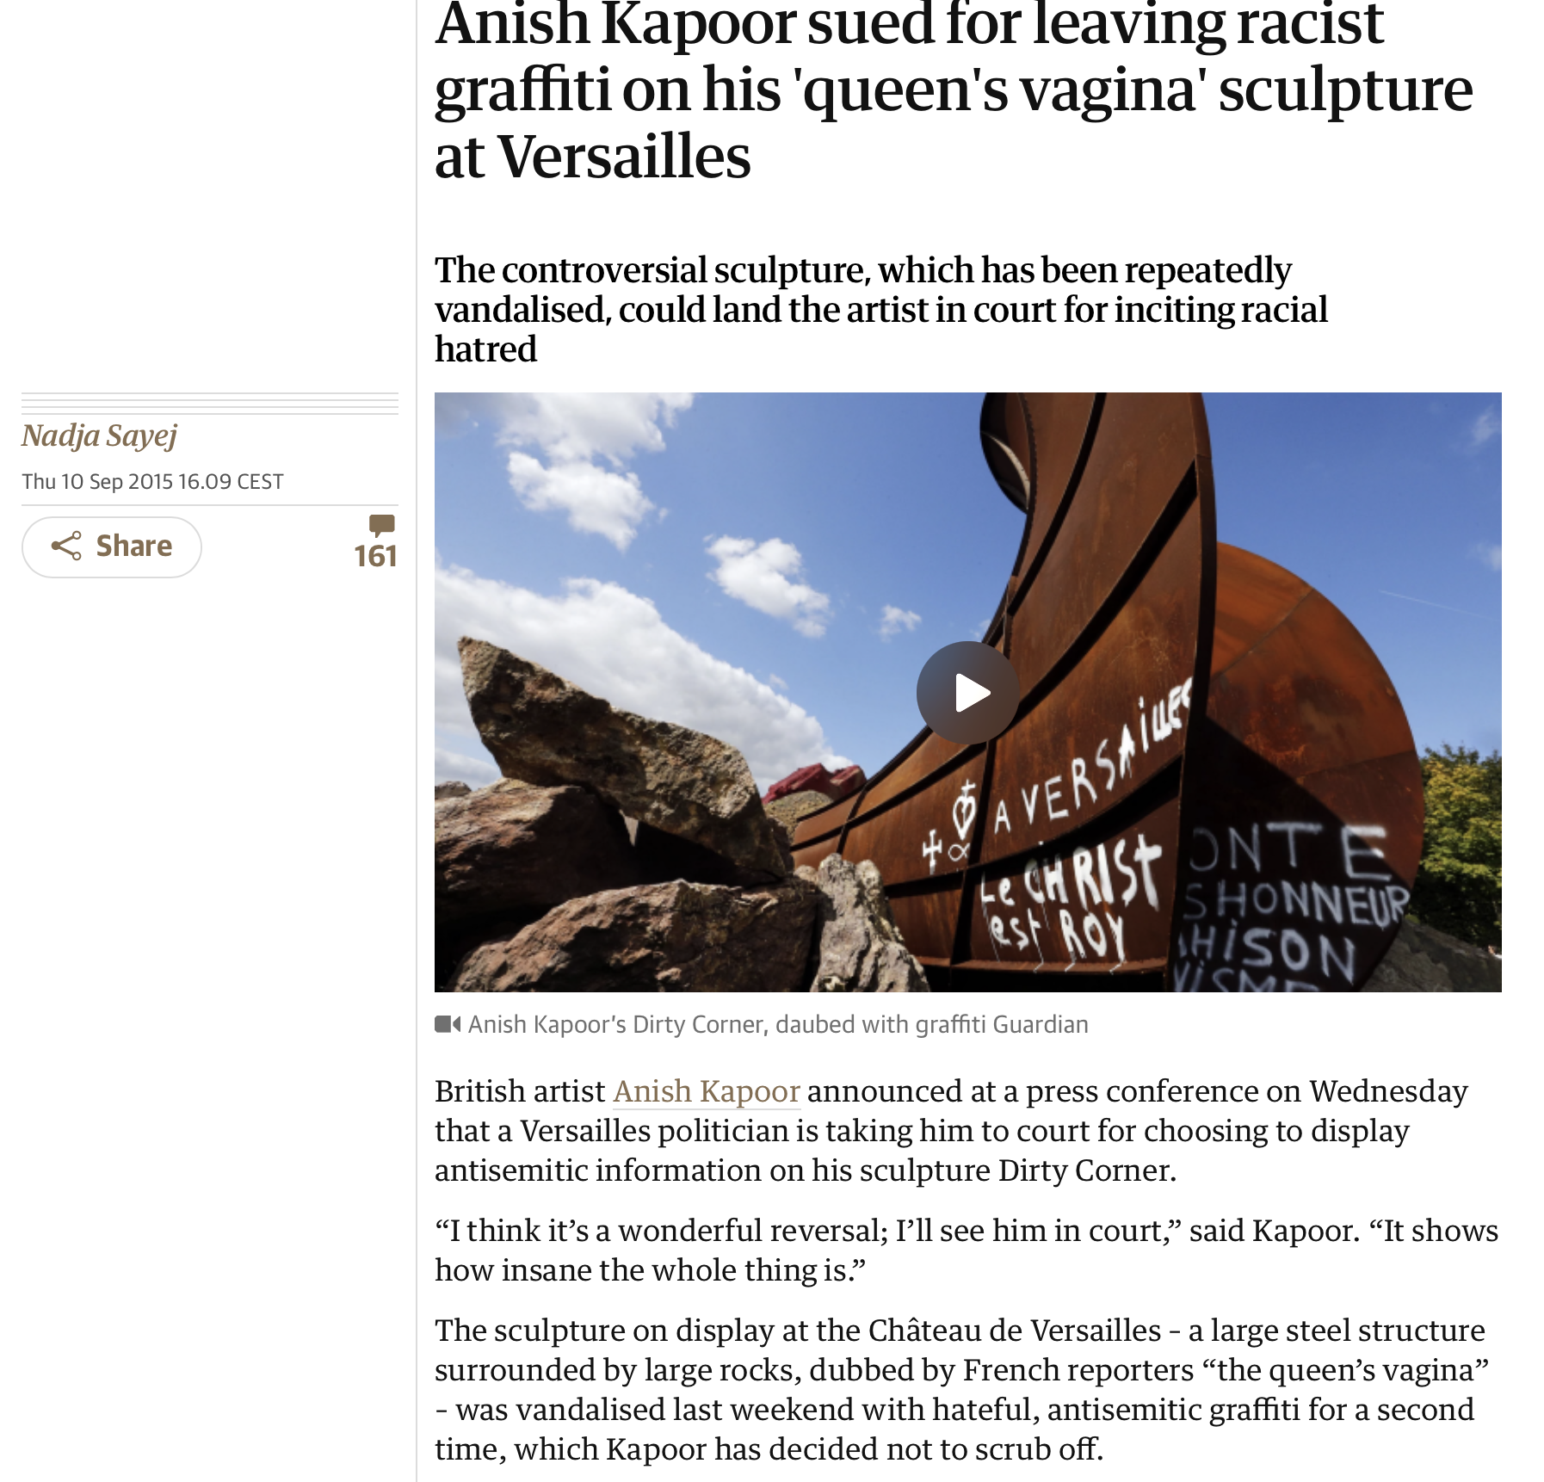

Slide 10
